Slide 1

Software Project Management

Slide 2
Contents
Putnam/SLIM Model,
Estimating by Analogy,
Cost Budgeting and Control

Slide 3
Putnam / SLIM Model

Slide 4
Putnam / SLIM Model
Putnam Model, also known as the SLIM Model (Software Life Cycle Management), is a software cost estimation model developed by Lawrence H. Putnam in the late 1970s.
It is based on the Rayleigh-Norden curve and emphasizes time-effort tradeoffs in software development.
Predicts effort, schedule, and cost using historical project data and an empirically derived equation.
It models the staffing pattern over time and is non-linear, accounting for diminishing returns when adding more effort to shorten development time.

Slide 5
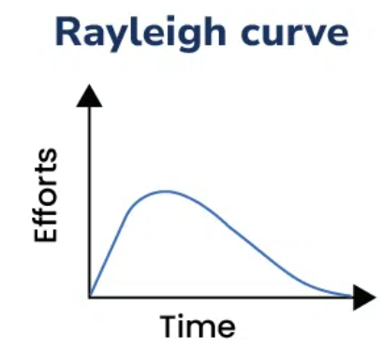
Rayleigh Curve
A bell-shaped curve that models how manpower is used over time in a software project.
Reflects slow ramp-up, peak staffing, and tapering off as the project nears completion.

Slide 6
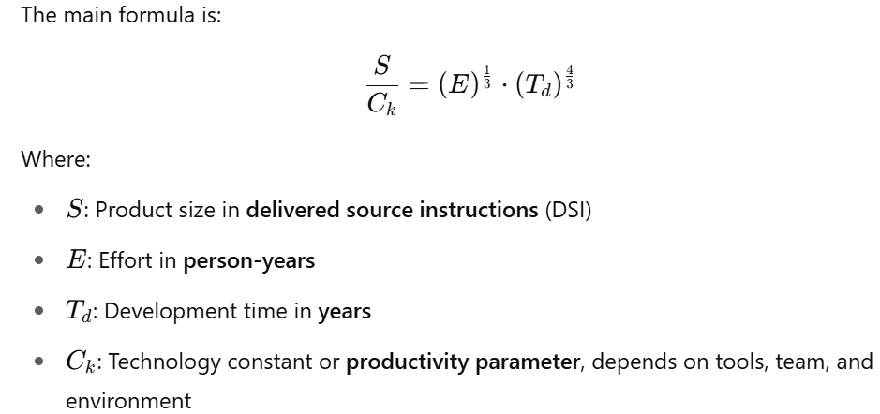
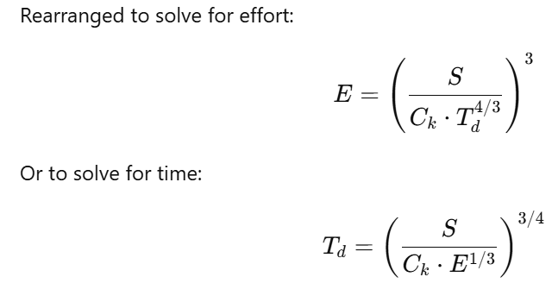
Putnam Equation

Slide 7
Assumptions of the SLIM Model
Project follows a waterfall model
Manpower builds up and reduces smoothly (Rayleigh curve)
Applicable mainly for large-scale software projects
Productivity (Cₖ) remains constant during the project

Slide 8
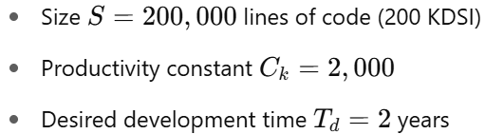
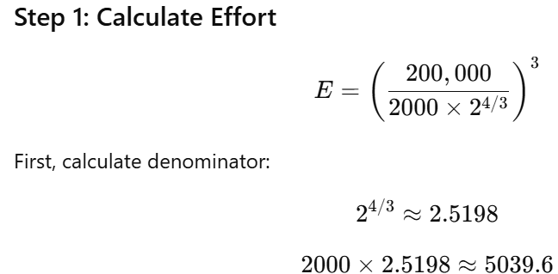
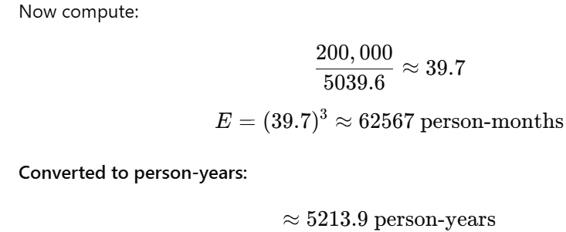
Example
Given:
Notes:
This is extremely high effort, indicating:
Either the project time is too short, or
The productivity constant (Cₖ) is too low for the tools/team assumed
Interpretation
More realistic values of (Cₖ) (e.g., 8000–12000 for modern agile teams) would result in lower effort.
Longer schedule (Td) reduces effort exponentially.

Slide 9
Estimating by Analogy

Slide 10
Estimating by Analogy
Comparative estimation technique where the effort, cost, or duration of a new software project is estimated based on actual data from similar past projects.
Steps Involved in Estimating by Analogy
  Identify past similar projects (from your organization or known repositories)
  Extract key metrics (e.g., size, complexity, effort, duration, cost)
  Compare and adjust for differences (team size, technology stack, risk level)
  Apply the adjusted data to estimate the new project
  Validate with subject matter experts or historical data
Notes:
Estimating by Analogy is a comparative estimation technique where the effort, cost, or duration of a new software project is estimated based on actual d
ata from similar past projects.
Core Idea: "If Project A is similar to Project B, and we know how much B cost or how long it took, we can use that to estimate A."

Slide 11
Example
Estimate by analogy, the effort and cost for a new e-commerce mobile app with ~100 user stories.
Similar Past Project: Consider a previously developed retail inventory app with- 90 user stories, Took 6 months, Required 1200 person-hours, Cost ₹12 lakhs
Step 1: Find Similarity
  The retail app and e-commerce app are similar in:
  Architecture (mobile + cloud backend)
  Technology (React Native + Firebase)
  Team experience
Step 2: Scale the Estimate
  New project = 100 stories → 11% more than 90 stories
  Estimated effort = 1200 × (100 / 90) = 1333 person-hours
  Estimated cost = ₹12 lakhs × (100 / 90) = ₹13.33 lakhs
  Estimated duration = 6 months × (100 / 90) ≈ 6.6 months

Slide 12
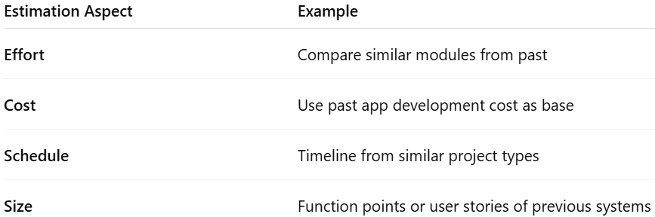
Applications of Estimating by Analogy
Notes:
Best suited when:
Historical project data is available
New project is similar in domain/technology
Quick, early-phase estimates are needed
Estimators lack access to detailed models (like COCOMO)

Slide 13
Advantages
Simple & Intuitive
Reuses Knowledge
Adaptable
Useful for Agile
Notes:
Simple & Intuitive-Based on real-world experience
Reuses Knowledge-Makes use of lessons from past projects
Adaptable-Can be tailored to team, tech, or context
Useful for Agile-Works well with story points or sprints

Slide 14
Cost Budgeting and Control

Slide 15
Cost Budgeting and Control
Cost budgeting is the process of allocating the overall cost estimate to individual work items or components of a software project to establish a cost baseline.
Objective:
  Define how much funding is needed and when
  Establish a cost baseline for performance measurement
  Enable tracking of actual costs vs. planned costs
Notes:
Purpose:
Define how much funding is needed and when
Establish a cost baseline for performance measurement
Enable tracking of actual costs vs. planned costs

Slide 16
Cost Control
Cost control is the ongoing process of:
  Monitoring project costs
  Measuring cost performance
  Ensuring project stays within the approved budget
  Taking corrective actions when there are cost overruns

Slide 17
Phases in Cost Budgeting and Control
A. Cost Budgeting Steps:
  Determine project WBS (Work Breakdown Structure)
  Estimate costs for each work package
  Aggregate costs to form the total project budget
  Define cost baseline with time-phased expenditure
B. Cost Control Steps:
  Track actual spending
  Compare with baseline
  Calculate cost variances (CV) and cost performance index (CPI)
  Forecast future performance
  Implement corrective actions

Slide 18
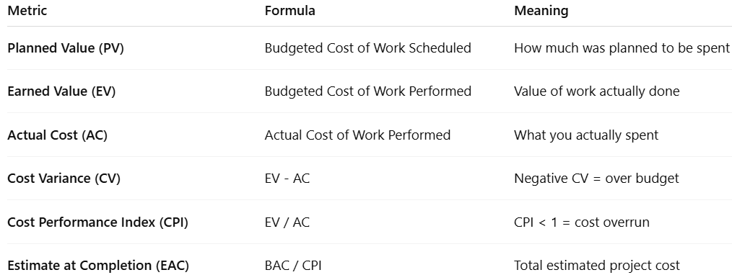
Key Terms & Formulas

Slide 19

Example
Project: Development of an ERP Module
  Total Budget (BAC) = ₹10,00,000
  Planned Work for 2 Months (PV) = ₹4,00,000
  Completed Work Value (EV) = ₹3,50,000
  Actual Cost so far (AC) = ₹4,50,000
Step 1: Calculate CV and CPI
Step 2: Forecast Final Cost
Notes:
the project is projected to exceed the budget by ₹2.82 lakhs if corrective action is not taken.

